Slide 1

GITAM SCHOOL OF TECHNOLOGY
(DEEMED TO BE UNIVERSITY)
BENGALURU CAMPUS, KARNATAKA , INDIA
“Classification of Leaves Based on their Species using Machine Learning Technique”
Bachelor of Technology in Computer Science and Engineering
By: Team 02
Ch. Avinash (321710306006)
Akash Sridhar(321710306001)
K Sai Samarth(321710306019)
M . Gopi Chand(321710306026)
Guided By:
Dr. Dayanand Lal N Assistant Professor Department of CSE, GST

Slide 2
Contents
Introduction
Objective
Problem Statement
Literature Survey
Architecture for classification of Leaf Species
Implementation
Results
Requirements
Advantages
Conclusion
References

Slide 3
Introduction
Plants are a crucial part of our ecosystem and some of them possess great medicinal values. This project focuses on the identification of plant species by performing image classification using machine learning techniques to find the medicinal benefits they could offer.
We decided to use Support vector machine algorithms to accomplish this. Support vector machine is a supervised learning concept where points are plotted on an n-dimensional space (where n is number of features you have) with the value of each feature being the value of a particular coordinate. Then, we perform classification by finding the hyper-plane that differentiates the two classes very well.

Slide 4
Objective
Extracting the useful data from bundle of images.
Classifying the leaves based on species using Support Vector Machine algorithm.
To increase the accuracy of model using GridSearchCV.
Predicting the leaf label and to find medicinal remedies that the leaf can offer.

Slide 5
Problem Statement
“To identify the classification of leaf species by image processing with machine learning techniques”.

Slide 6
Literature Survey

Slide 7
Literature Survey
Paper | Author | Conclusion
plant classification using machine learning algorithm | K.B.Shobana and P.Perumal, IEEE publications. (2020 6th International Conference on Advanced Computing and Communication Systems (ICACCS) ​ | 92% (ANN) 98% (SVM)
CNN Approaches for Classification of Indian Leaf Species Using Smartphones : | M. Vilasini and P. Ramamoorthy , tech Science Press(2020) | Using edge detection and CNN algorithm for classifying Indian leaf species
Plant Leaf Recognition Using a Convolution Neural Network: | Wang-Su Jeon and Sang-Yong Rhee, ResearchGate.(2017) | Created 2 models with by adjusting weights of CNN . Model is able to classify even if leaf was damaged.

Slide 8
Literature Survey
Image-Based Plant Disease Detection: A Comparison of Deep Learning and Classical Machine Learning Algorithms | Draško Radovanović 1 , Slobodan Đukanović (18-22 February 2020) | Used Plant_village dataset from tensorflow SVM-0.917(Accuracy) KNN-0.78 CNN-0.993
Plant_Classification_Based_on_Leaf_Recognition | Abdolvahab Ehsani Rad (July 2010) | Gray-Level Co-occurrence matrix (GLCM) and Principal Component Analysis (PCA) algorithms have been applied to extract the leaves texture features.
Detection and Classification of Plant Leaf Diseases Using Image | Savita N. Ghaiwat, Parul Arora(2014) | This paper provides an overview of different classification techniques used for plant leaf disease classification.

Slide 9

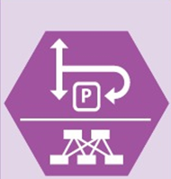

Architecture for classification of Leaf Species
Flavia-Dataset Features Algorithm (Support vector Machine)
Input Image
Predictions
Remedies

Slide 10
Implementation

Slide 11
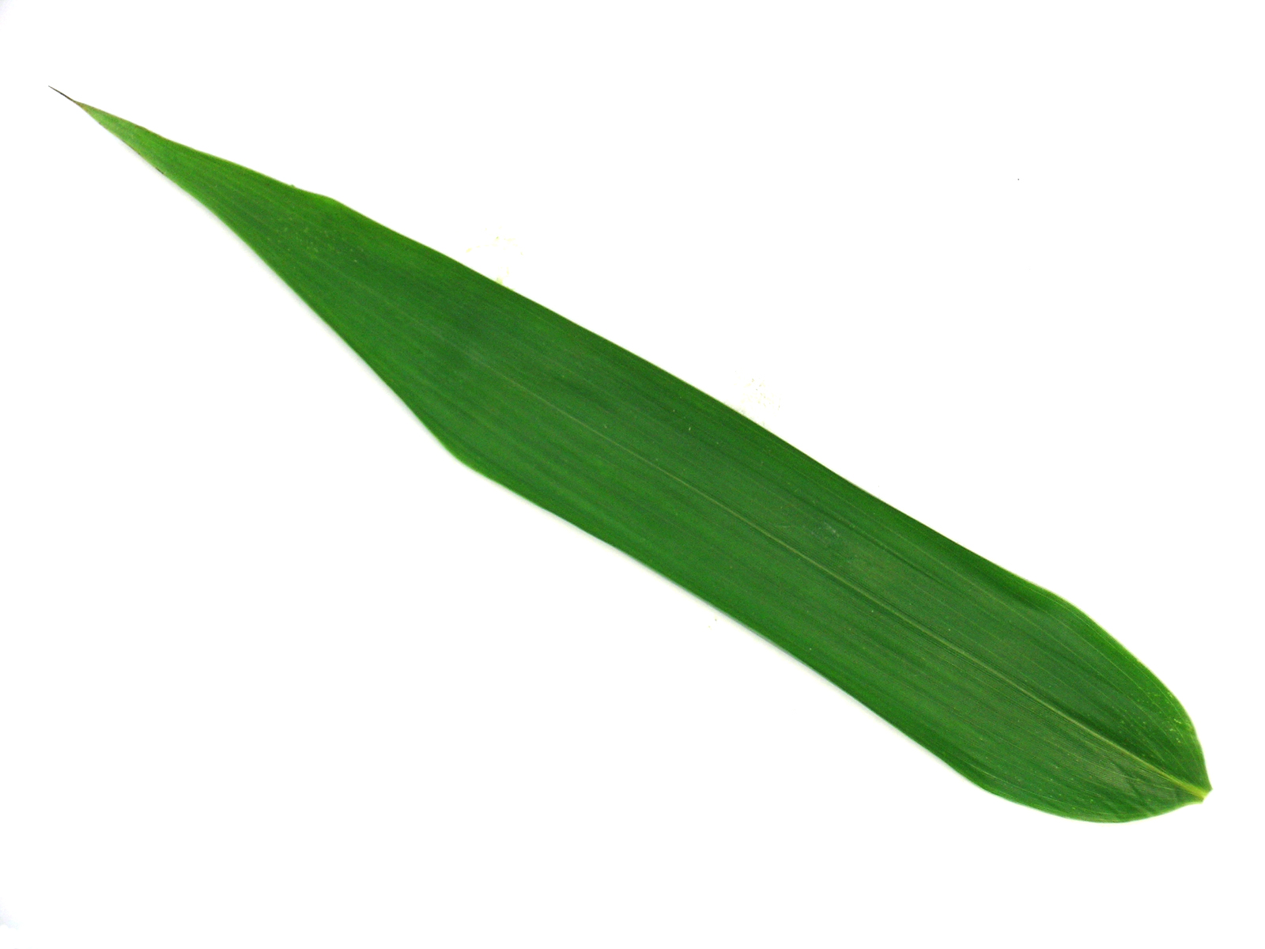
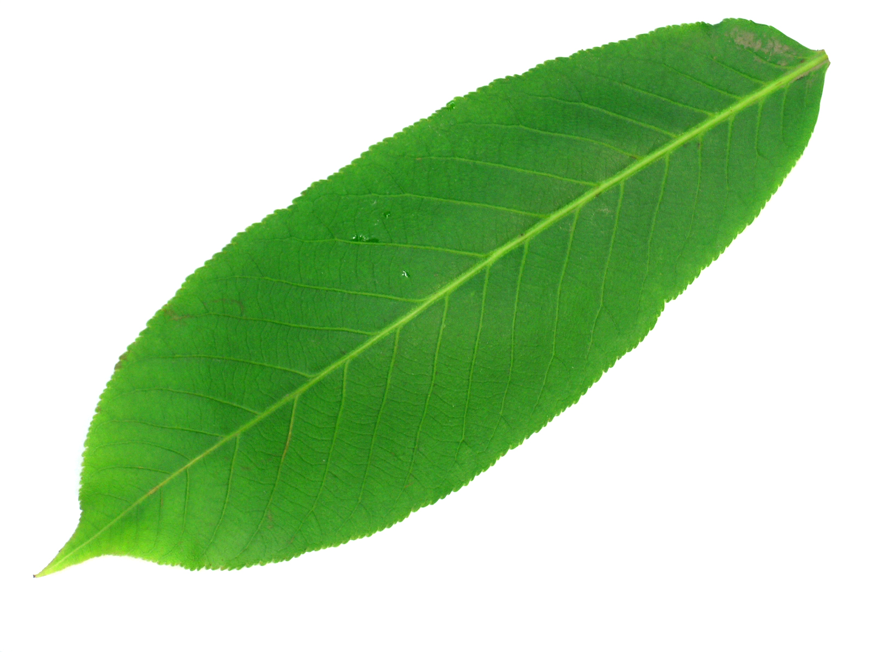
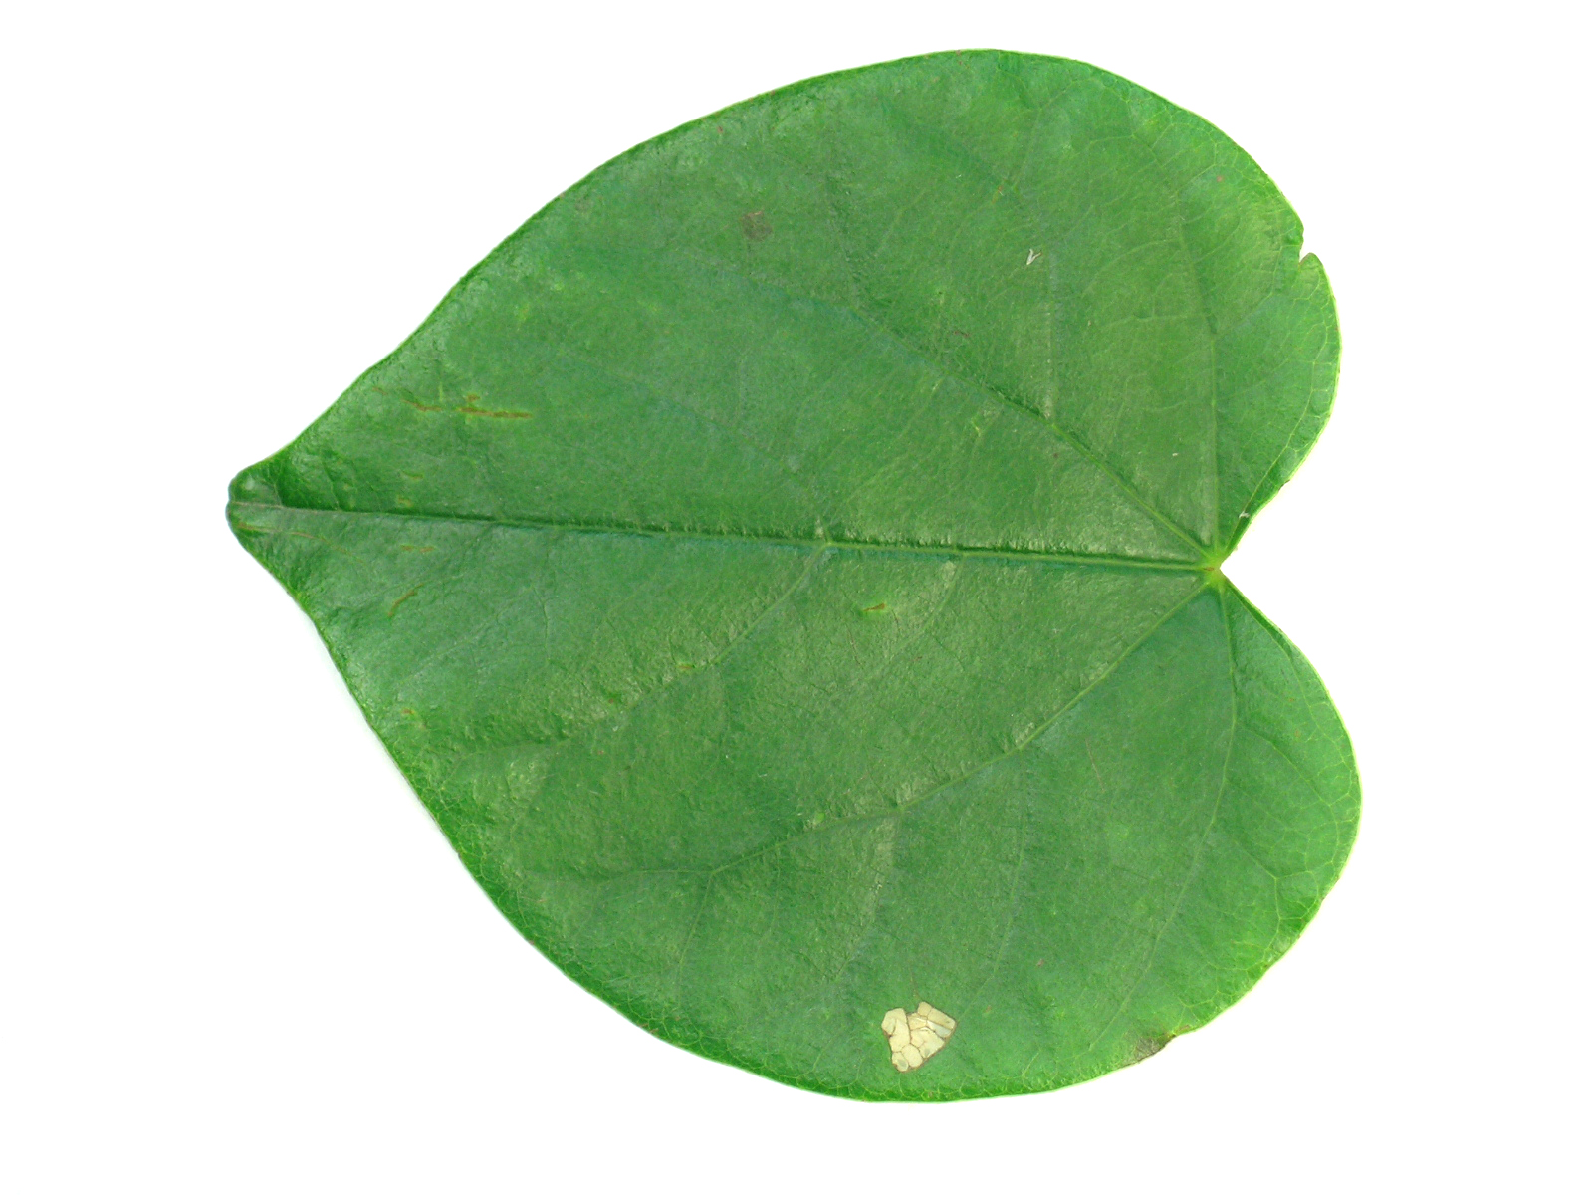
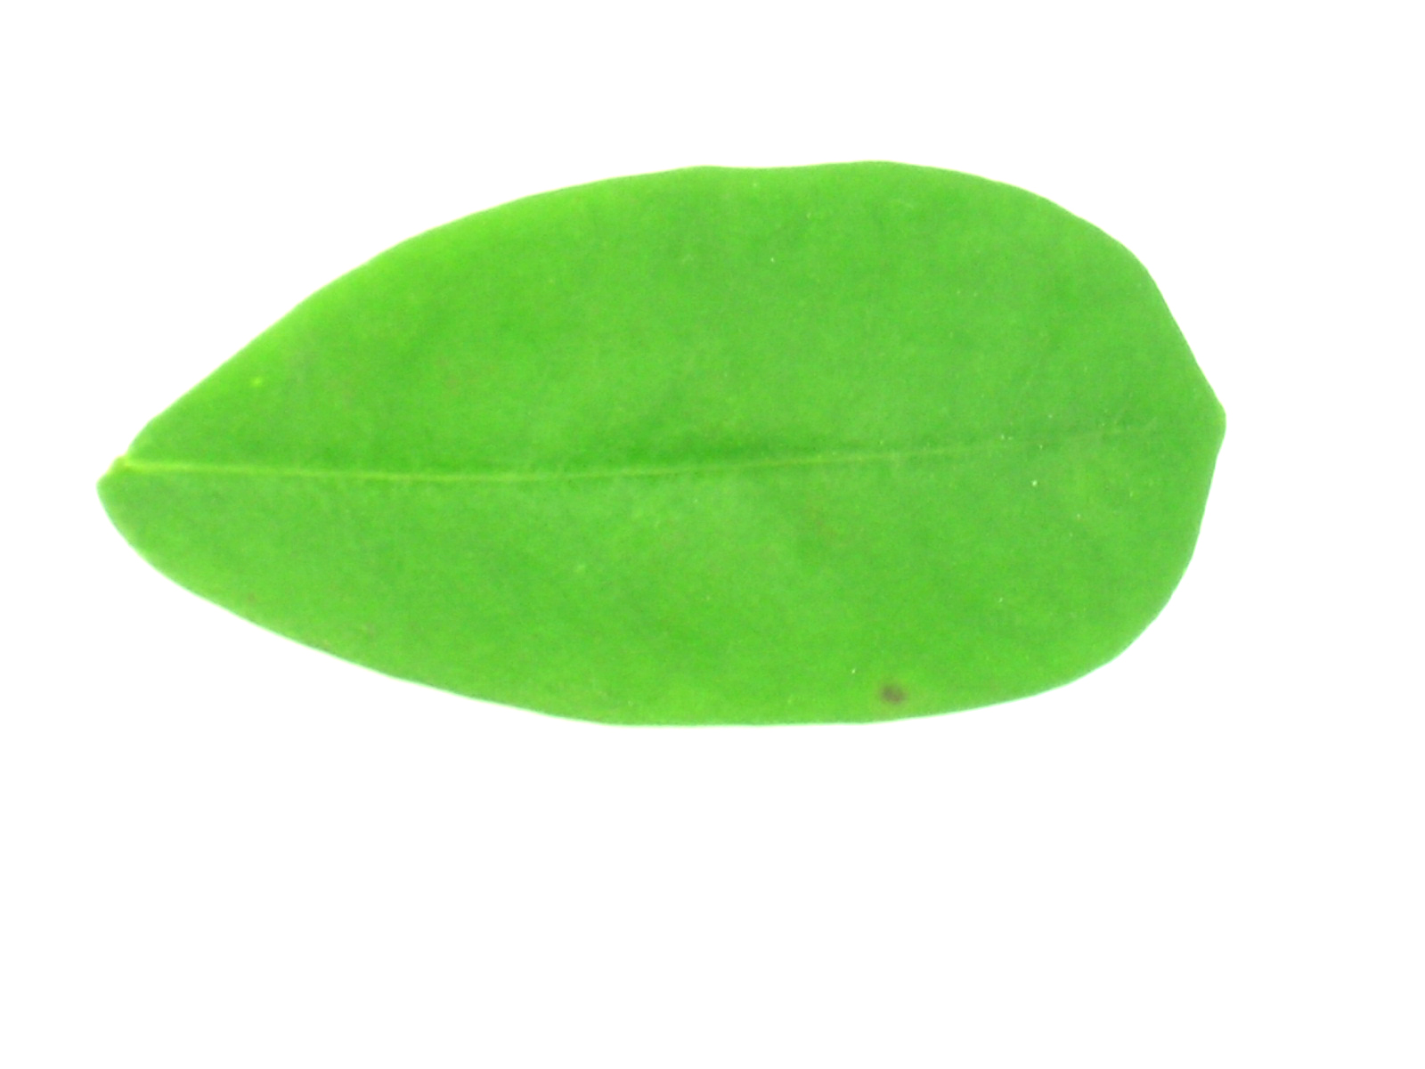
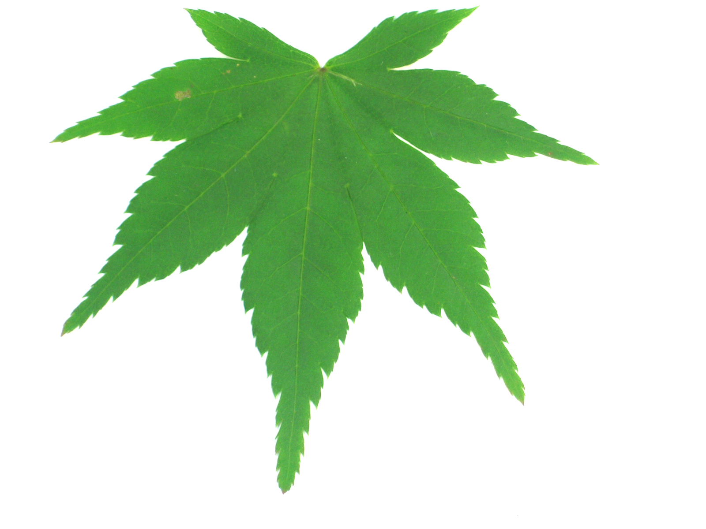
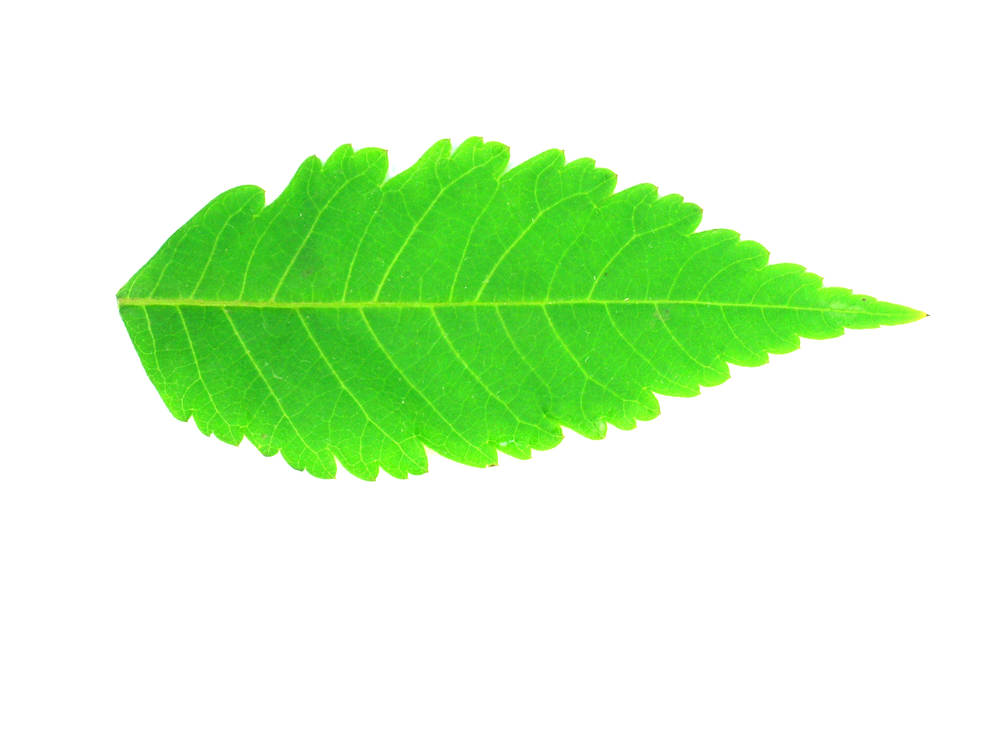
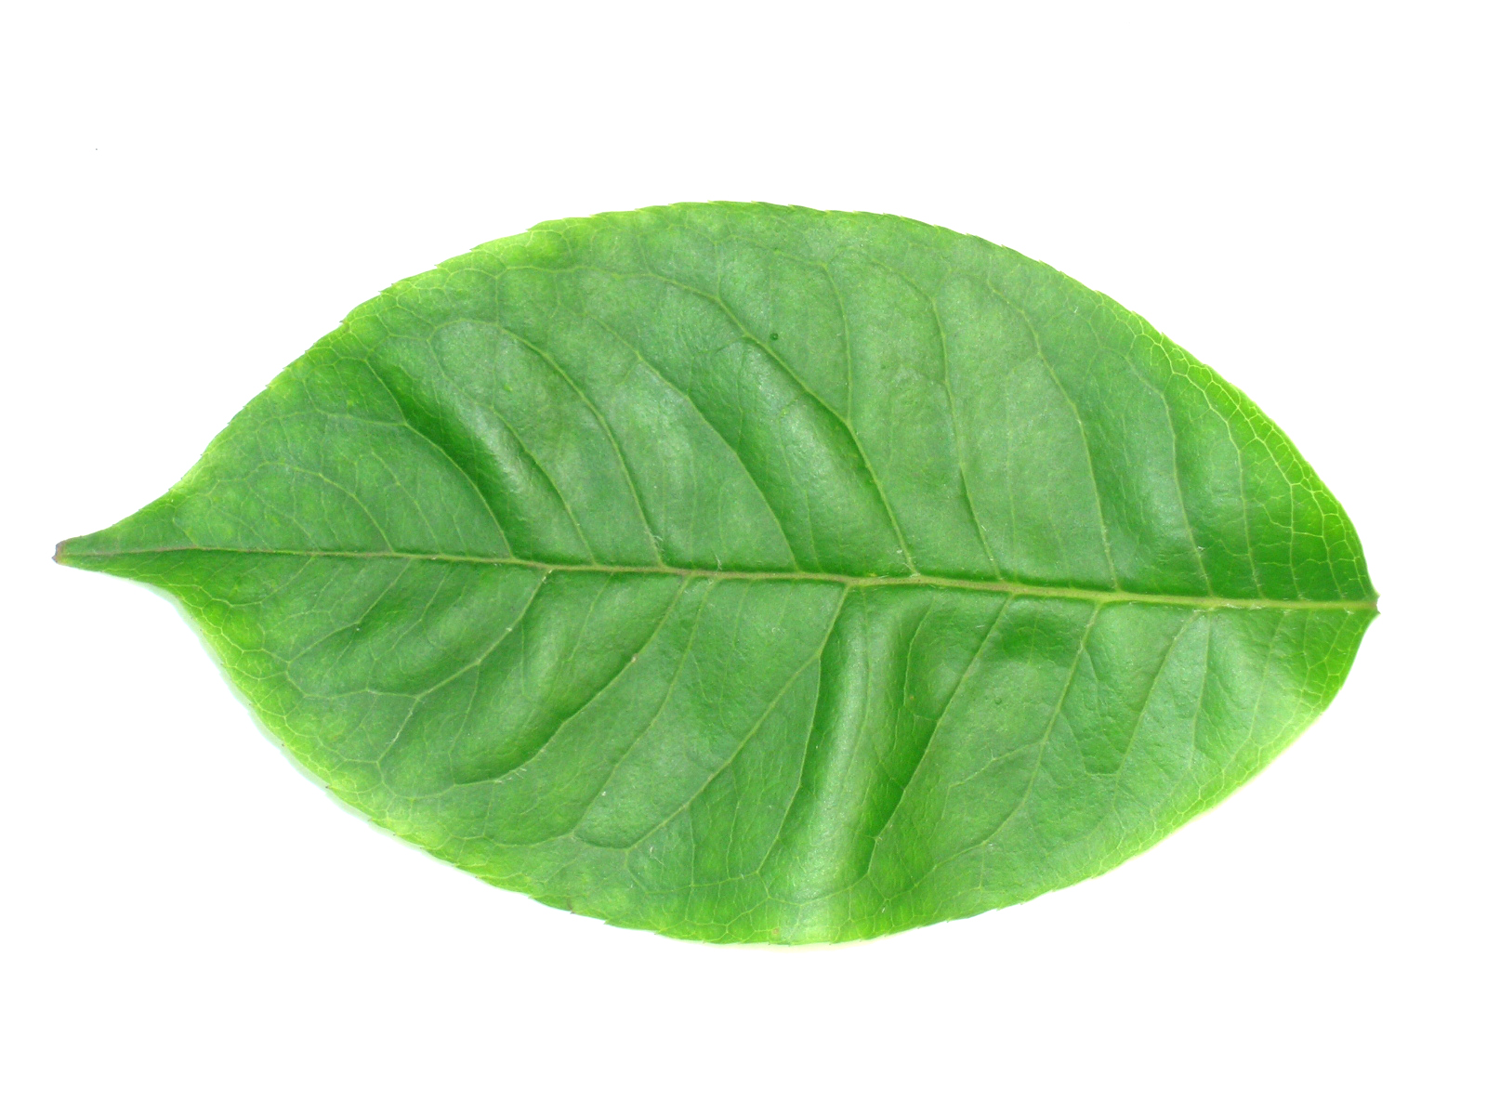
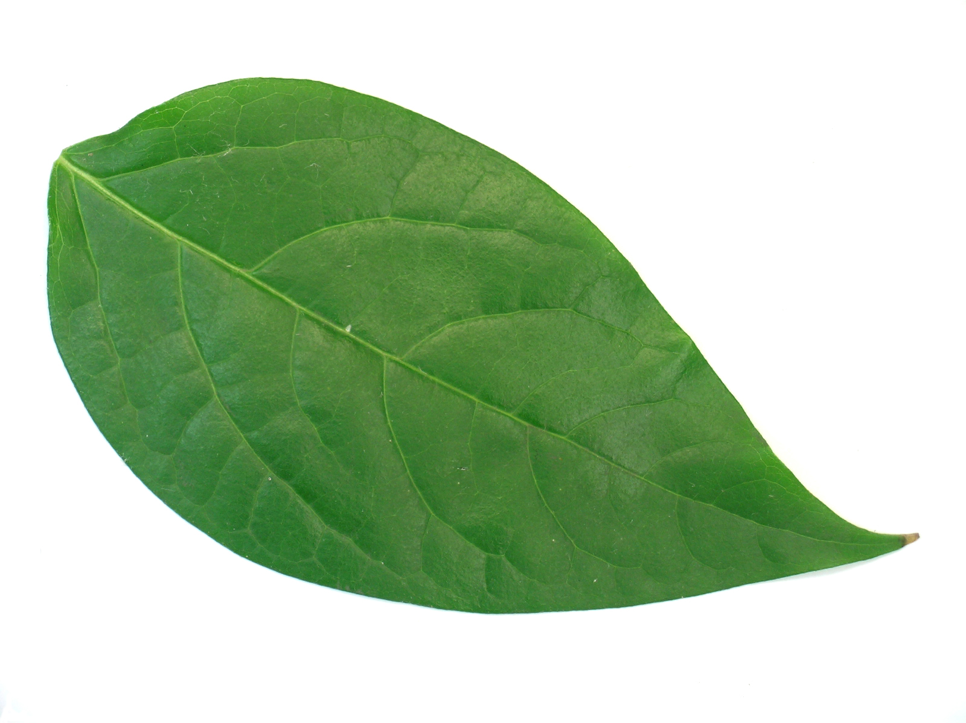
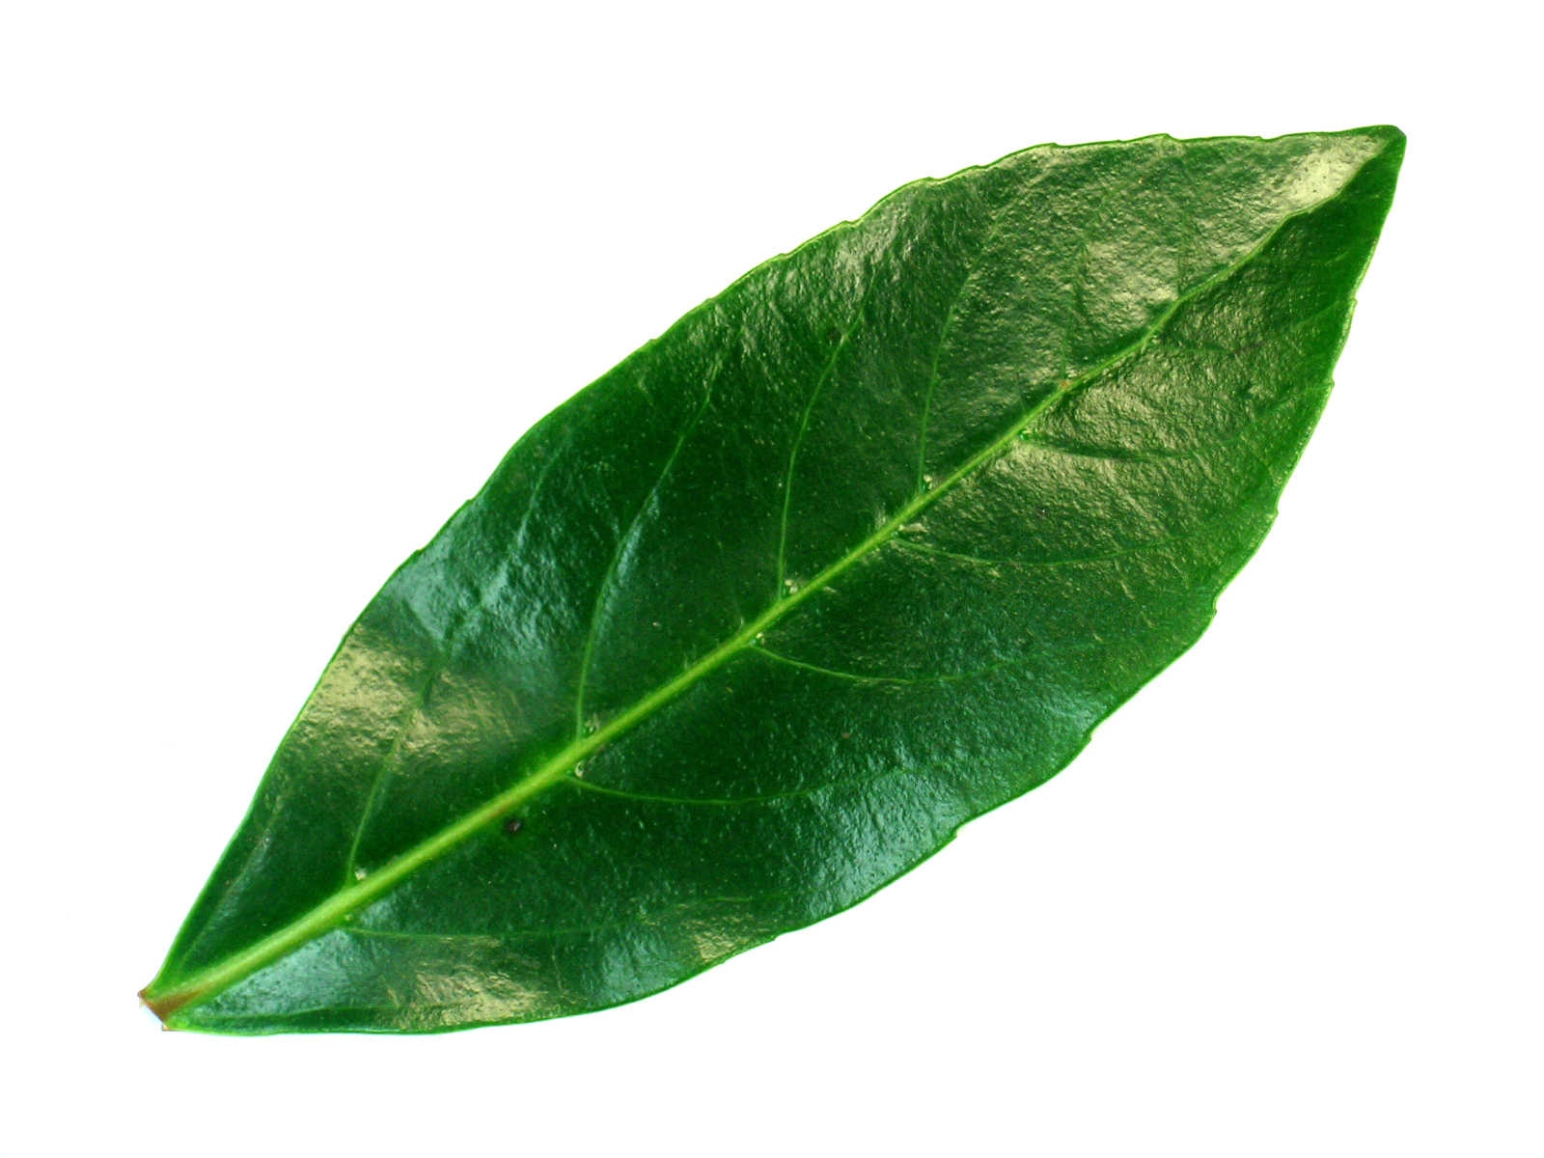
Data Gathering
Flavia Datasets
This leaf data set contains both health and damaged leaves.
Dataset contains 3621 images of healthy The images are in high resolution JPG format and with white background

Slide 12
Data Feature Extraction
Shape Features
Colour Features
Texture Features
Area
Perimeter
pysiological_length
pysiological_width
mean_r
mean_g
mean_b
stddev_r
sttdev_g
sttdev_b
contrast
correlation
entropy

Slide 13
Data Feature Extraction
Shape features:
Area: Just counting the number of pixels of binary value 1 on smoothed leaf image. It is denoted as A.
Perimeter: Denoted as p, leaf perimeter is calculated by counting the number of pixels consisting leaf margin.
Physiological_length: The simplest human interfered component of our set of rules is which you want to mark the 2 terminals of the main vein of the leaf via mouse click. The distance among the 2 terminals is described because the physiological length. It is denoted Lp.
Physiological_width: Drawing a line passing through the 2 terminals of the principle vein, you possibly can plot infinite strains orthogonal to that line. The wide variety of intersection pairs among the ones strains and the leaf margin is likewise infinite. The longest distance among factors of these intersection pairs is described on the physiological width .It is denoted by Wp

Slide 14
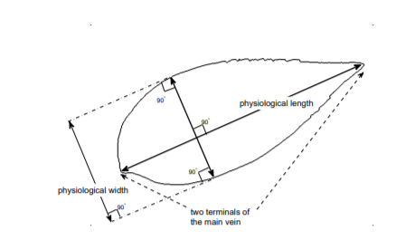
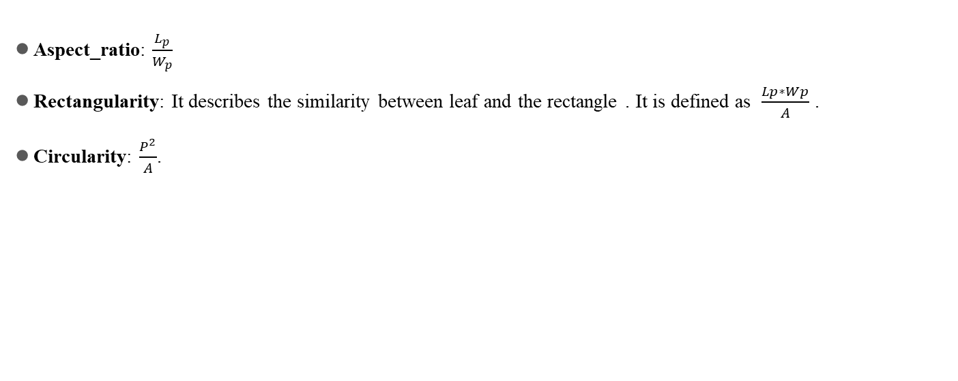
Data Feature Extraction
Aspect_ratio: $\frac{L_{p}}{W_{p}}$
Rectangularity: It describes the similarity between leaf and the rectangle . It is defined as $\frac{Lp∗Wp}{A}$ .
Circularity: $\frac{P^{2}}{A}$.

Slide 15
Data Feature Extraction
Texture Feature:
Contrast : In visible belief of the actual world, contrast is decided through the distinction withinside the coloration and brightness of the item and different gadgets in the identical discipline of view.
Correlation: Correlation is the process of transferring a clear out mask, also known as a kernel, over an image and computing the total amount of merchandise at each location.
Inverse_difference_moments: It is the measure of local homogeneity.
Entropy: The entropy or common facts of an image is a degree of the diploma of randomness withinside the image.

Slide 16
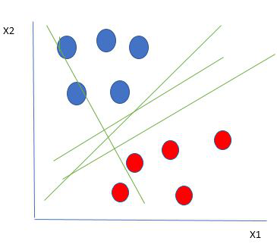
Support Vector Machine
Support Vector Machine (SVM) is a supervised machine learning algorithm used for both classification and regression.
Hyperplane is will divide data into different categories.
Dividing Dataset by using Hyperplane

Slide 17
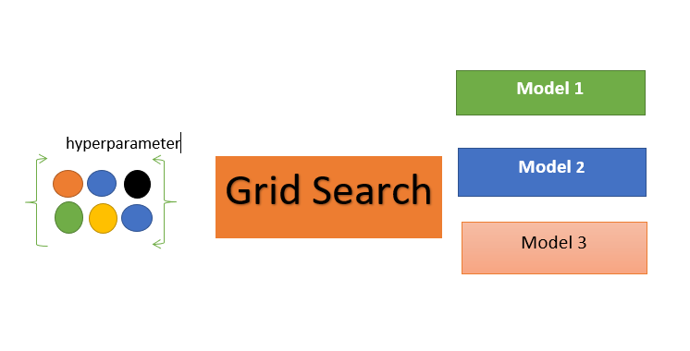
GridSearchCV
GridSearchCV is a technique to search through the best parameter values from the given set of the grid of parameters.
GridSearchCV is basically considering all the combinations of the candidates in finding the best parameters.
GridSearchCV

Slide 18
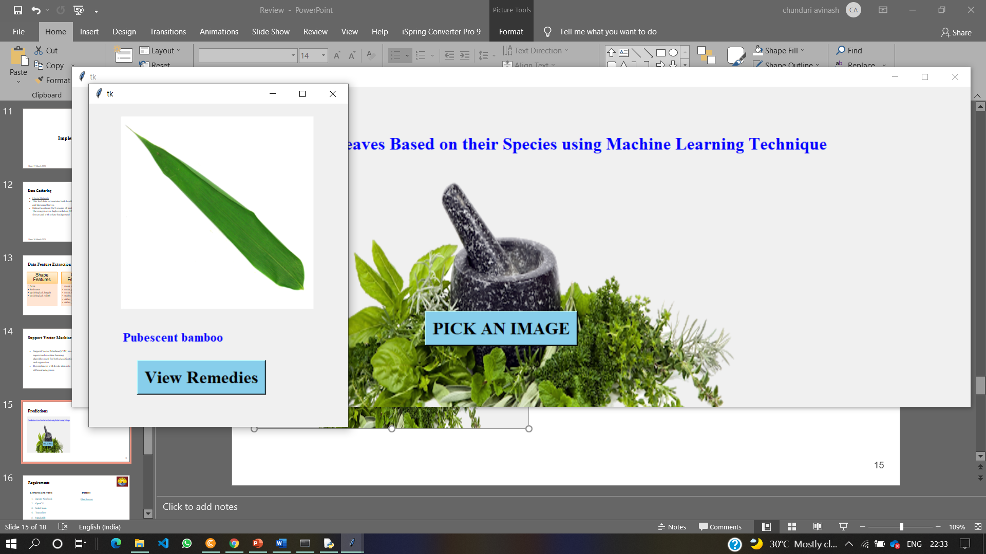
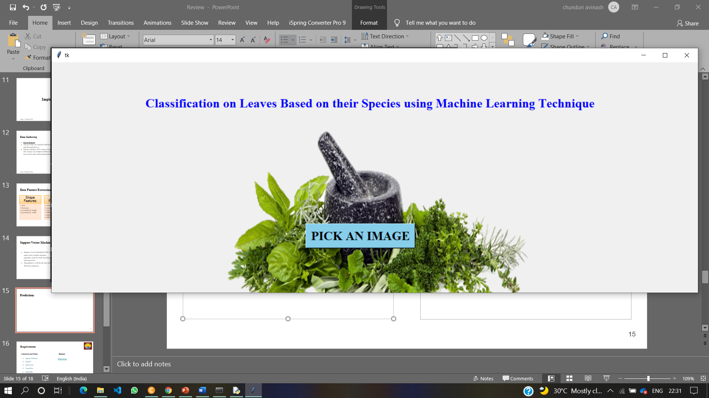
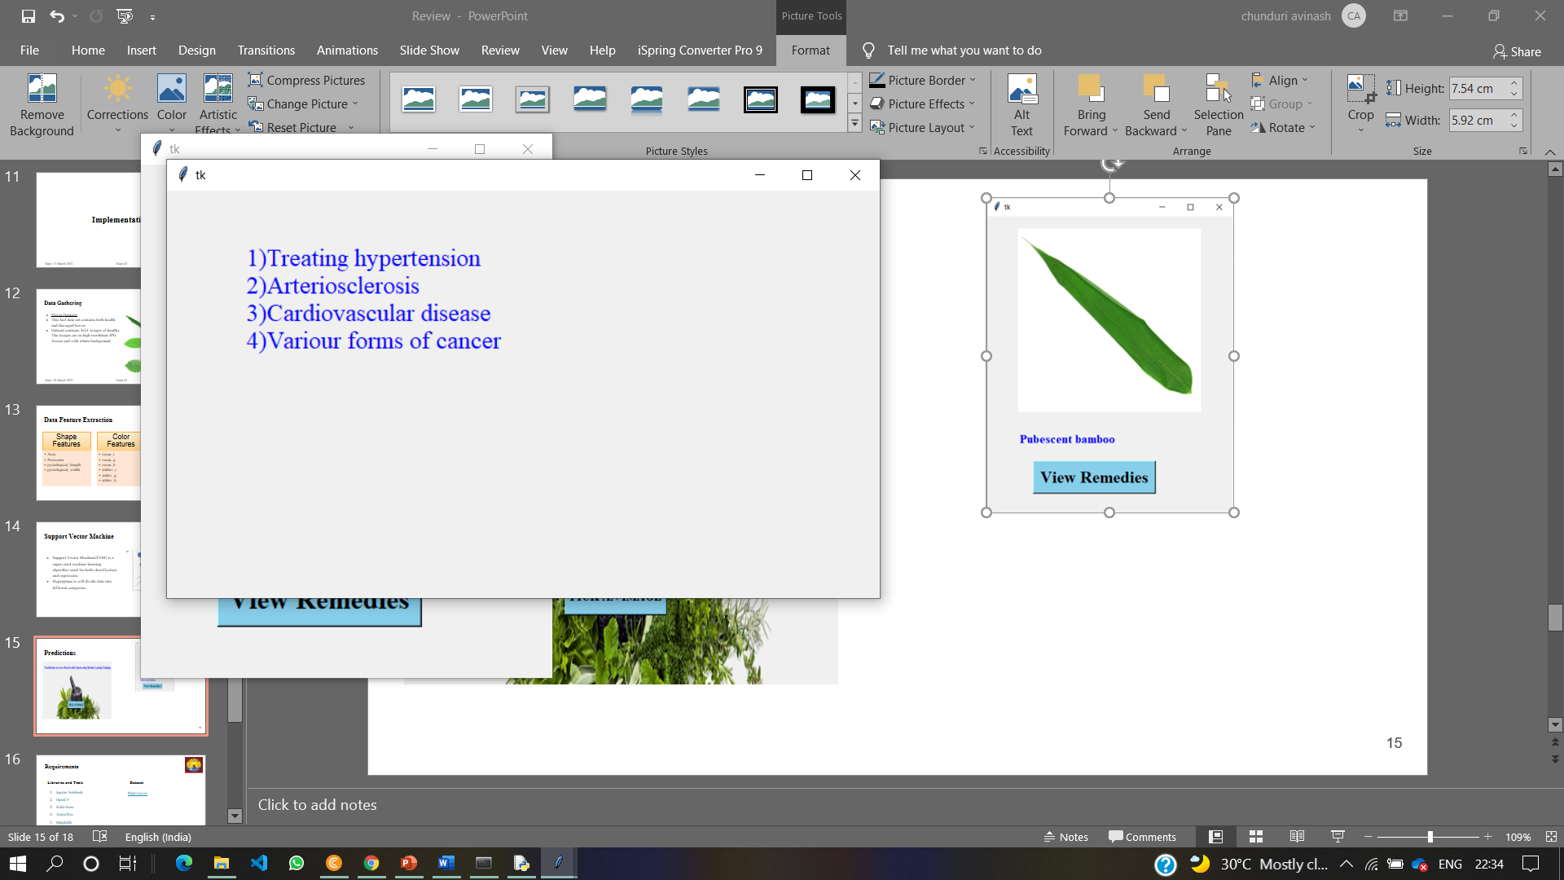
Predictions
Label of the selected image
GUI interface for picking an image
Remedies of the selected leaf

Slide 19
Requirements
Libraries and Tools
JupyterNotebook
OpenCV
Scikit-learn
Matplotlib
Numpy
Pandas
tkinter
Hardware Requirements
Dual Core processor
RAM minimum 4GB
Hard Disk minimum 1GB
Speed 1.1GHZ
Software Requirement
Operating system :windows 10
Frontend GUI : tkinter
IDLE : python 3.6
Anaconda prompt

Slide 20
Advantages
SVM was found to be competitive with the best current machine learning methods. The computational complexity of SVM is reduced to a quadratic optimization problem, making the complexity of the decision rule and the frequency of error easy to regulate.
Identifying medicinal values getting from the leaf for example: blue indigo has medicinal values which helps to reduce ringworms, sores on skin and mouth ulcers.

Slide 21
Conclusion
The dataset reveal 32 different types of plant leaves.
The classification method is based on the SVM classifier, which has a higher accuracy, faster training speed, and a simple structure.
Feature Extraction processes the image to get 12 features to construct the SVM input vector.
The accuracy and execution time of the proposed solution are used to test its performance. The efficiency of the classifier can be enhanced in future research by integrating efficient kernel functions.

Slide 22
Future Enhancements
By creating Mobile Application That can detect the Medicinal Remedies of the leaf which is surrounding to us.
The Performance of the model can increase by using the various kernel parameters.
The feature extraction part will be ignored while using Deep Learning Algorithms, resulting in a higher score.

Slide 23
References
plant classification using machine learning algorithm: K.B.Shobana and P.Perumal, IEEE publications.
CNN Approaches for Classification of Indian Leaf Species Using Smartphones : M. Vilasini and P. Ramamoorthy , tech Science Press.
Plant Leaf Recognition Using a Convolution Neural Network: Wang-Su Jeon and Sang-Yong Rhee, ResearchGate.
Image-Based Plant Disease Detection: A Comparison of Deep Learning and Classical Machine Learning Algorithms: Draško Radovanović 1 , Slobodan Đukanović (18-22 February 2020).
Plant_Classification_Based_on_Leaf_Recognition: Abdolvahab Ehsani Rad (July 2010).
Detection and Classification of Plant Leaf Diseases Using Image : Savita N, Parul Arora(2014)
Plant Leaf Recognition using Shape based Features and Neural Network classifiers: Jyotismita Chaki, and Ranjan Parekh,International Journal of Advanced Computer Science and Applications (IJACSA), 2011, vol. 2, no. 10.

Slide 24
Thank You

